Slide 1
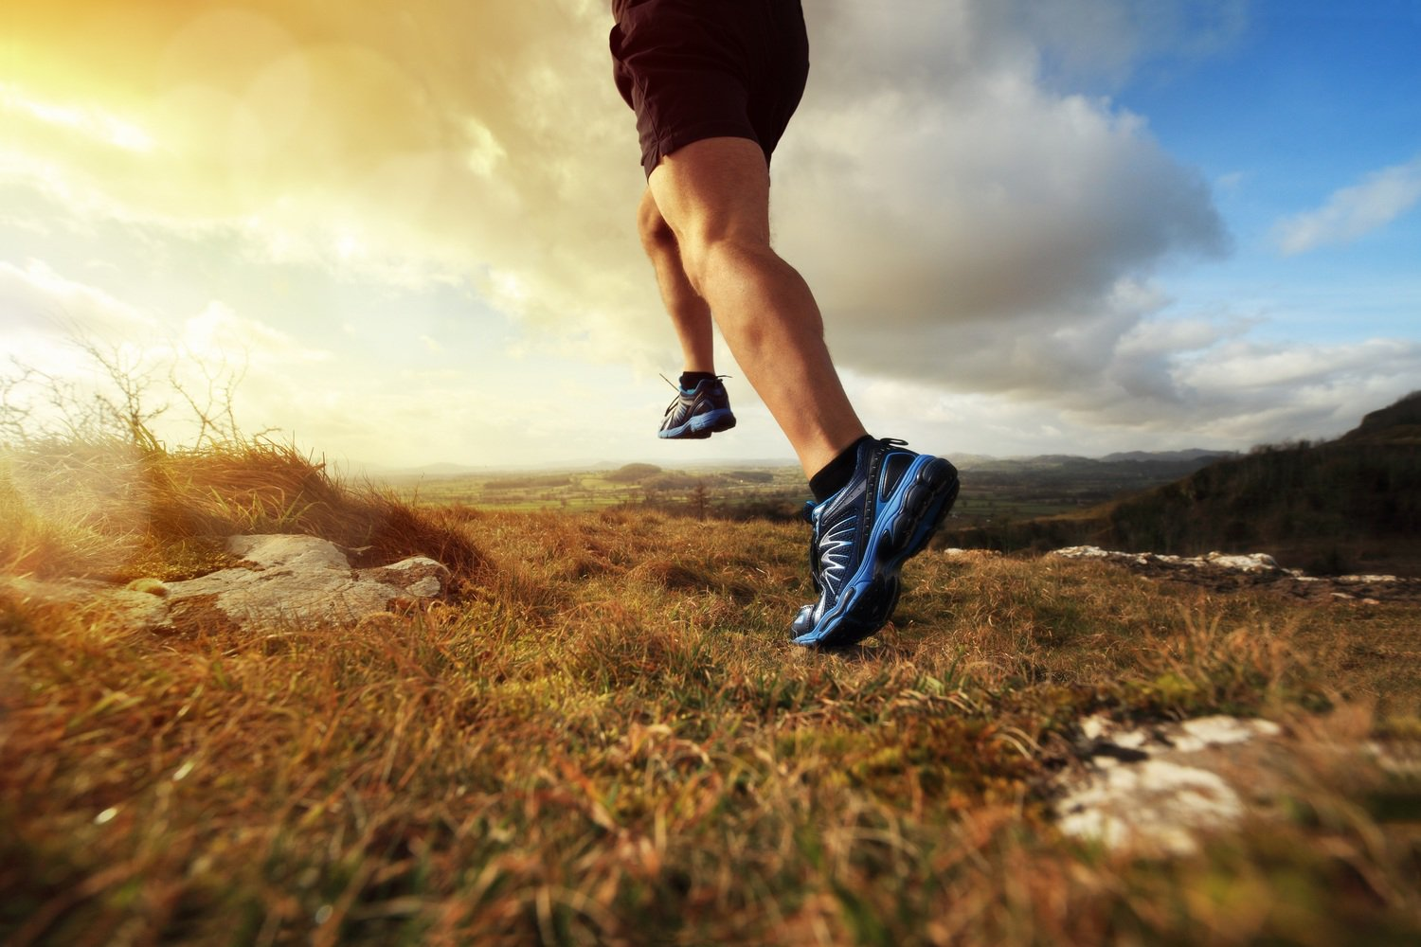

Bio
Data
Device
Bio Data Device
Swasthya – Health Partner
International Project Management
Winter Semester - 2018
Prof. Dr. Gerd Moeckel
Dr. Josef Hermanns
SRH Hochschule Heidelberg 12-Nov-2018 Aishwarya Chandradhara

Slide 2

Bio
Data
Device
Technologies
Aishwarya Chandradhara
Rohit Dipankar
Sarang Samarth
Sreehari Mullapulli
User Interface
Ashkan Es Haghi
Kaustav Dutta
Marketing & Sales
Karamjeet Singh
Sagar Bhave
Sunny Banawalikar
SRH Hochschule Heidelberg 12-Nov-2018 Aishwarya Chandradhara

Slide 3

Bio
Data
Device
Problem Statement
Introduction
Market Trend Analysis
Project Overview
Parameters
Technologies
System Architecture
Software and UI Overview
Data Flow
User Interface
User Interface Samples – Web Application
User Interface Samples – Mobile Application
Marketing & Sales
Project Plan
Milestones
Resources
Marketing, Sales and Costs
Competitor Analysis
Target Consumers
Packages
Product Promotion Strategies
Table of Content
SRH Hochschule Heidelberg 12-Nov-2018 Aishwarya Chandradhara

Slide 4
Bio
Data
Device
Problem Statement
In this project, the customer of your IT-consulting company is a small “Life Science and Health Technologies Company”. Their core business is the support of medicinal treatments by advanced technologies.
You and Your team has to develop a concept for a “Bio Data Device” using latest technologies.
SRH Hochschule Heidelberg 12-Nov-2018 Aishwarya Chandradhara

Slide 5
Bio
Data
Device
Introduction
Biodata devices, devices that’re able to measure numbers of body parameters like heart frequency, blood pressure, blood oxygen content and physical activities etc.
Types of Bio Data Devices:
Measuring by touch/contact
Embedded in the body
Fully submerged
SRH Hochschule Heidelberg 12-Nov-2018 Aishwarya Chandradhara

Slide 6
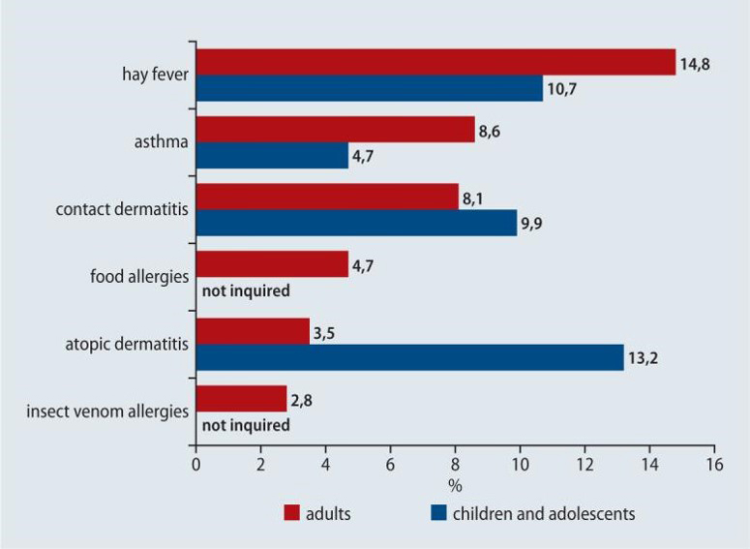
Bio
Data
Device
Market Trend Analysis
Analyzing the past and current market behavior and dominant patterns we observe that there are some common areas in which people are getting affected.
CVD accounts for 45% of all deaths in Europe
Cardiovascular disease (CVD) causes more than half of all deaths across the European Region.
Diabetes is a major risk factor and trigger for cardiovascular disease.
80% of premature heart disease and stroke is preventable.
SRH Hochschule Heidelberg 12-Nov-2018 Aishwarya Chandradhara

Slide 7

Bio
Data
Device
Project Overview
In recent times technology plays an important role in shaping the lifestyle of a person. It is prevalent in every walk of life and is being used in almost every field of study. We as an IT consultancy are going to develop a project for “Life Science and Health Technologies Company” which would help them in detecting various symptoms, parameters and anomalies in human body and provide medication as well as medical advice to the customer base of company using latest technology at our disposal.
The infrastructure provided by our project would be able to store data at a secure location as well as refurbish and display it in such a way that even a common man would be able to understand it.
SRH Hochschule Heidelberg 12-Nov-2018 Aishwarya Chandradhara

Slide 8
Bio
Data
Device
Parameters
Must Have
Weight Tracking (Body-Mass Index)
Diet Monitoring
Heart Rate & Stress Monitoring
Blood Pressure
Blood Cell Analysis
ECG
Body Temperature
Medication Tracking
Blood Oxygen
Blood Sugar
Respiration Tracking
Should Have
Step Count
Sleep Monitoring
Caffeine consumption
Water Consumption
Nice to Have
Urinary Tract Infection
Eye Sensor
Alcohol consumption
Body Odor
SRH Hochschule Heidelberg 12-Nov-2018 Aishwarya Chandradhara

Slide 9
Bio
Data
Device
Problem Statement
Introduction
Market Trend Analysis
Project Overview
Parameters
Technologies
System Architecture
Software and UI Overview
Data Flow
User Interface
User Interface Samples – Web Application
User Interface Samples – Mobile Application
Marketing & Sales
Project Plan
Milestones
Resources
Marketing, Sales and Costs
Competitor Analysis
Target Consumers
Packages
Packaging Based on Consumers
Product Promotion Strategies
Table of Content
SRH Hochschule Heidelberg 12-Nov-2018 Aishwarya Chandradhara

Slide 10

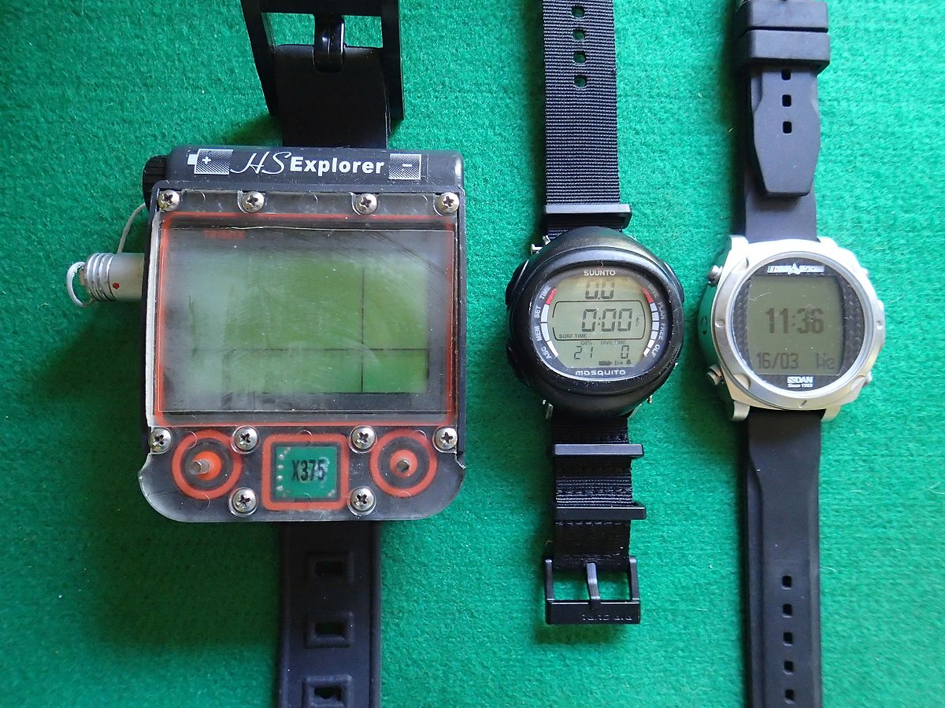
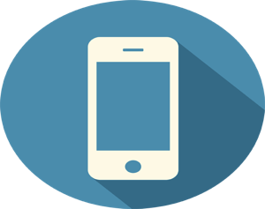

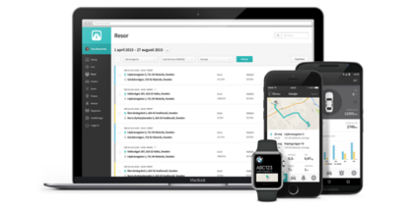


Bio
Data
Device
System Architecture
SRH Hochschule Heidelberg 12-Nov-2018 Rohit Dipankar

Slide 11
Bio
Data
Device
Software and UI Overview
We propose to use Python to code for our Hub as our target is to make the HUB self-learning
We will be using Microsoft Azure SQL Database, which is a cloud-based database.
The AES algorithm will be used for encrypting the data
We will be using KIVY, which is a framework written in Python to build multi-touch applications.
Why
Python
??!!
Why
MS Azure SQL ??!!
Why
AES algorithm
??!!
Why
KIVY
??!!
SRH Hochschule Heidelberg 12-Nov-2018 Rohit Dipankar

Slide 12
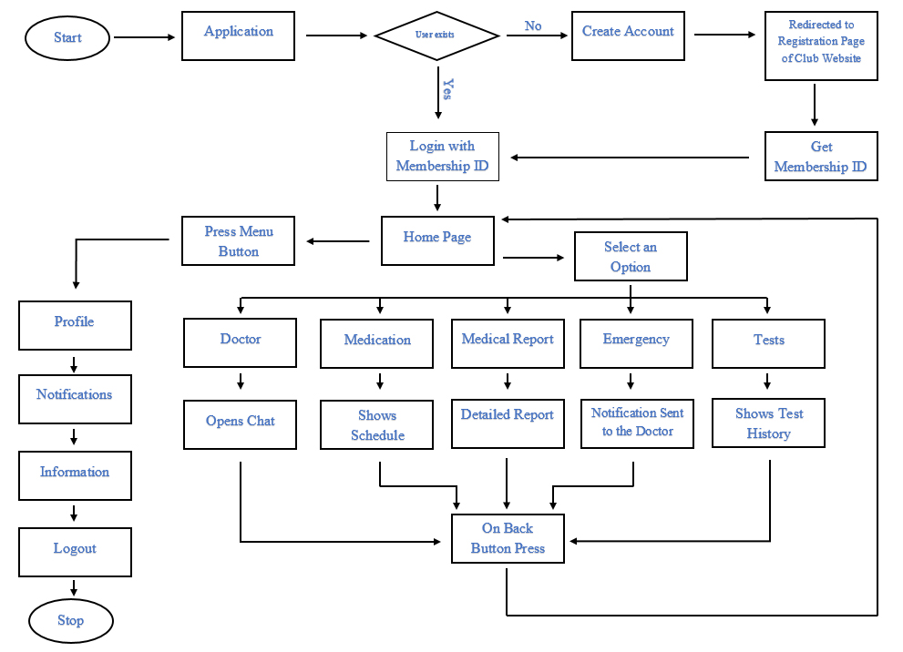
Bio
Data
Device
Data flow - User
SRH Hochschule Heidelberg 12-Nov-2018 Rohit Dipankar

Slide 13
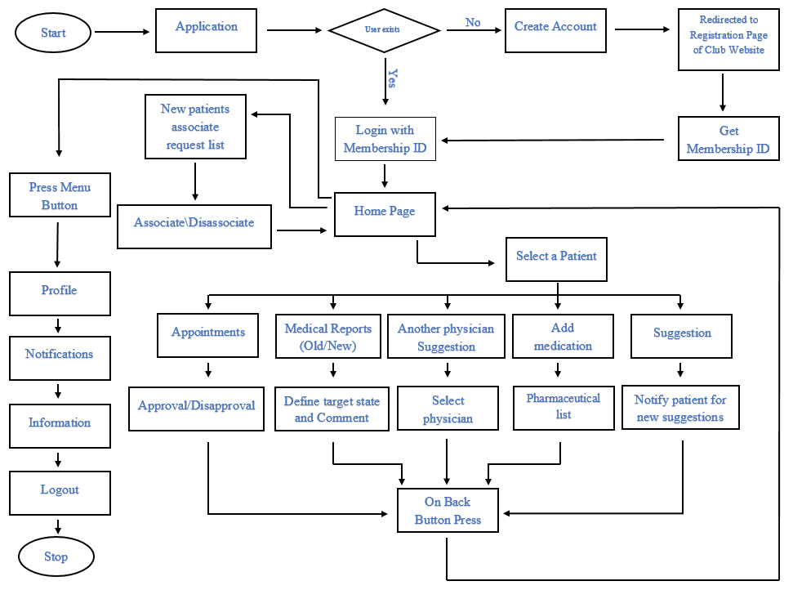
Bio
Data
Device
Data flow - Doctor
SRH Hochschule Heidelberg 12-Nov-2018 Rohit Dipankar

Slide 14
Bio
Data
Device
Problem Statement
Introduction
Market Trend Analysis
Project Overview
Parameters
Technologies
System Architecture
Software and UI Overview
Data Flow
User Interface
User Interface Samples – Web Application
User Interface Samples – Mobile Application
Marketing & Sales
Project Plan
Milestones
Resources
Marketing, Sales and Costs
Competitor Analysis
Target Consumers
Packages
Packaging Based on Consumers
Product Promotion Strategies
Table of Content
SRH Hochschule Heidelberg 12-Nov-2018 Aishwarya Chandradhara

Slide 15
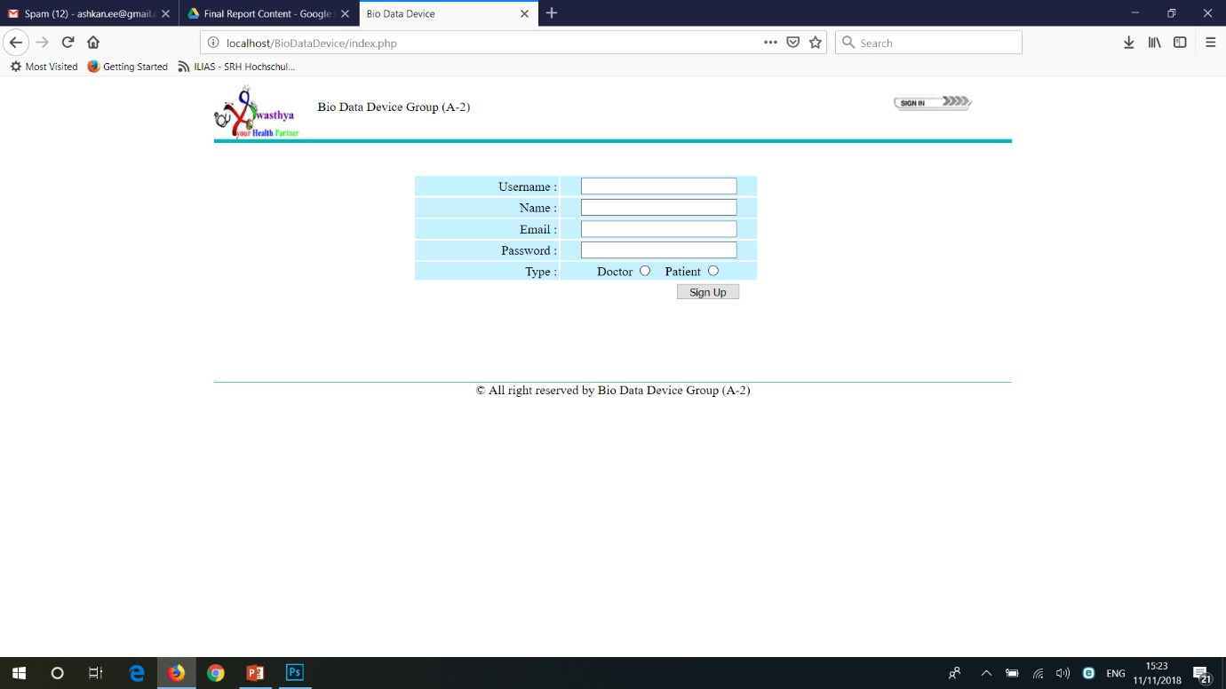
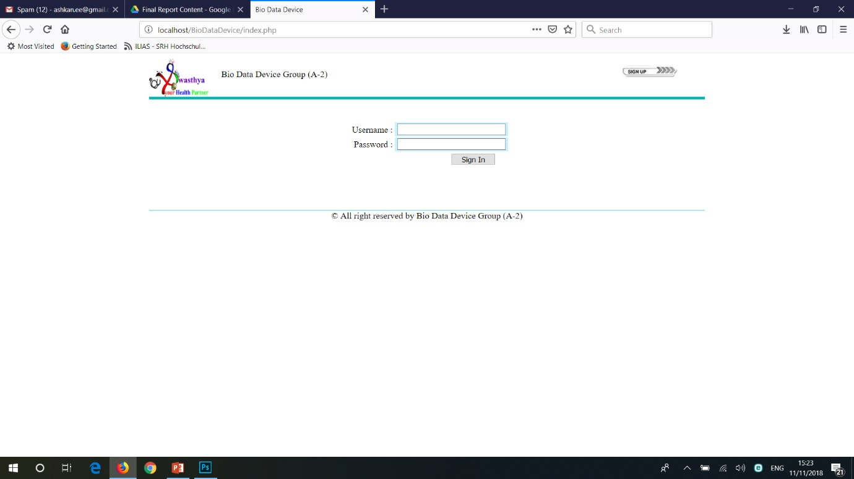
Bio
Data
Device
UI Samples – Web Application
SRH Hochschule Heidelberg 12-Nov-2018 Rohit Dipankar

Slide 16
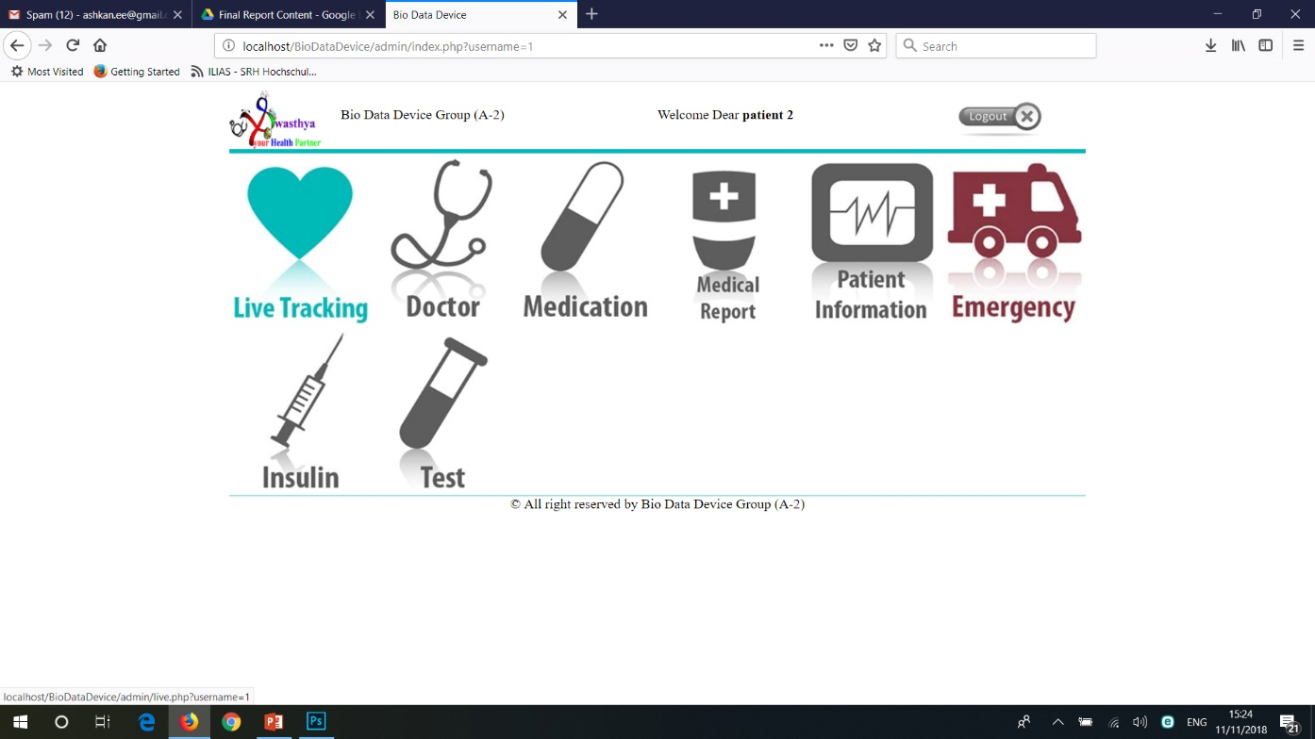
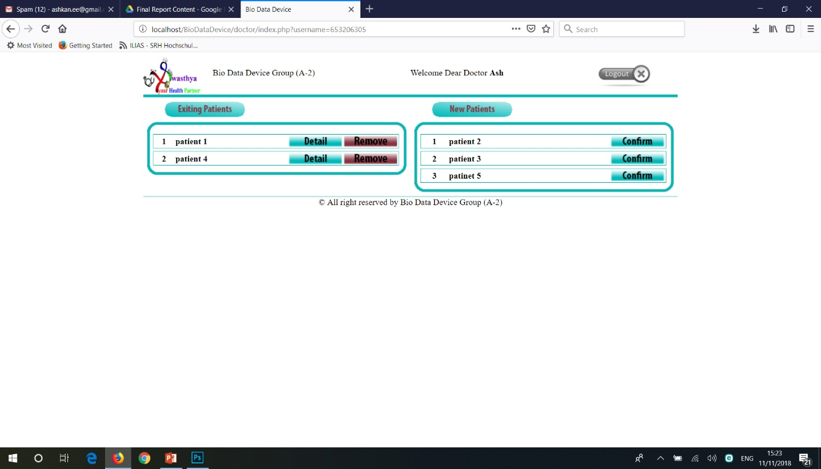
Bio
Data
Device
UI Samples – Web Application
SRH Hochschule Heidelberg 12-Nov-2018 Rohit Dipankar

Slide 17
Bio
Data
Device
Problem Statement
Introduction
Market Trend Analysis
Project Overview
Parameters
Technologies
System Architecture
Software and UI Overview
Data Flow
User Interface
User Interface Samples – Web Application
User Interface Samples – Mobile Application
Marketing & Sales
Project Plan
Milestones
Resources
Marketing, Sales and Costs
Competitor Analysis
Target Consumers
Packages
Packaging Based on Consumers
Product Promotion Strategies
Table of Content
SRH Hochschule Heidelberg 12-Nov-2018 Aishwarya Chandradhara

Slide 18
Bio
Data
Device
Project Plan
No. | Activity Name | Start Date (dd.mm. yyyy) | End Date (dd.mm. yyyy) | Duration (No. of working days) | Predecessors
1 | Project initialization and Authorization | 03.01.2019 | 23.01.2019 | 13
2 | Project Planning and organization | 24.01.2019 | 10.05.2019 | 71 | 1 d)
3 | Project Execution, Controlling and Steering. | 13.05.2019 | 14.08.2020 | 317 | 2 l)
4 | Project Closing and liquidation | 17.08.2020 | 07.10.2020 | 45 | 3u, 3v, 3w
SRH Hochschule Heidelberg 12-Nov-2018 Sagar Bhave

Slide 19
Bio
Data
Device
Milestones
Date | Milestone Title
23/01/2019 | Project initialization and Authorization
10/05/2019 | Project Planning and organization
14/08/2020 | Project Execution, Controlling and Steering.
07/10/2020 | Project Launch, Closing and liquidation
SRH Hochschule Heidelberg 12-Nov-2018 Sagar Bhave

Slide 20
Bio
Data
Device
Resources
There will be 15 Employees working on the Project who will be divided into two Sprint Teams of 7 each with both managed by the Scrum Master
A Sprint Team will consist of
Web Developer
API Developer
Mobile Developer
Device Connection Developer
Configuration Developer
QA Engineer
SRH Hochschule Heidelberg 12-Nov-2018 Sagar Bhave

Slide 21
Bio
Data
Device
Problem Statement
Introduction
Market Trend Analysis
Project Overview
Parameters
Technologies
System Architecture
Software and UI Overview
Data Flow
User Interface
User Interface Samples – Web Application
User Interface Samples – Mobile Application
Marketing & Sales
Project Plan
Milestones
Resources
Marketing, Sales and Costs
Competitor Analysis
Target Consumers
Packages
Packaging Based on Consumers
Product Promotion Strategies
Table of Content
SRH Hochschule Heidelberg 12-Nov-2018 Aishwarya Chandradhara

Slide 22
Bio
Data
Device
Marketing, Sales and Costs
Competitor Analysis
Bio Data Devices
Bio Data Corporation
Apple smart watch: Calorie count
Samsung application: Blood pressure, Sleep monitoring
BioAsthama: Asthma tracker
SRH Hochschule Heidelberg 12-Nov-2018 Sagar Bhave

Slide 23







Bio
Data
Device
Marketing, Sales and Costs
Target Consumers
Existing Customers of the Company
Consumers with Critical Illness
Consumers with Illness
Lifestyle monitoring Consumers/ Fitness Freaks
Medical Consultants
Medical Institutions
Pharmaceuticals
SRH Hochschule Heidelberg 12-Nov-2018 Sagar Bhave

Slide 24
Bio
Data
Device
Marketing, Sales and Costs
Packages
Premium Package
Standard Package
Money Waiver Package
Basic Package
Free Version
Customised Package
SRH Hochschule Heidelberg 12-Nov-2018 Sagar Bhave

Slide 25
Bio
Data
Device
Marketing, Sales and Costs
Packaging Based on Consumers
Existing Customer Base
Premium Package free for first 3 months
Customers with Critical Illness
Premium Package Trial version
Package Expiry
Customers with Illness Monitoring
25 days Free Trial + 5 Days Premium Package.
Inactivity Threshold Increased to a week.
Customers with Lifestyle Monitoring/Fitness Freaks
30 Days Free Trial + Days of the Hub side.
Special Notification Service to Motivate Users.
Various Charts and Fitness Analysis
Includes health tips
Money building Customer Base
Medical Consultants
25 days of Application & Hub + 5 days Of Premium in the Free Trial
Free Application for a year once registered
Medical Institution
Application part over the Desktops/Laptops
Free application over Hub
Pharmacy
Basic Sales based Customer
Standard Package suggestion
SRH Hochschule Heidelberg 12-Nov-2018 Sagar Bhave

Slide 26
Bio
Data
Device
Marketing, Sales and Costs
Product Promotion Strategies
Chain Marketing
AdSense Partnership
Marketing visit
Dedicated Website/Blogs
Community
Business Cards
Brochure
Social Media
SRH Hochschule Heidelberg 12-Nov-2018 Sagar Bhave

Slide 27
Bio
Data
Device
Special thanks for your valuable time
Thanks
Aishwarya Chandradhara
Ashkan Es Haghi
Karamjeet Singh
Kaustav Dutta
Rohit Dipankar
Sagar Bhave
Sarang Samarth
Sreehari Mullapulli
Sunny Banawalikar
SRH Hochschule Heidelberg 12-Nov-2018 Aishwarya Chandradhara

Slide 28
Bio
Data
Device
Any Questions ??!!
SRH Hochschule Heidelberg 12-Nov-2018 Aishwarya Chandradhara

